Slide 1
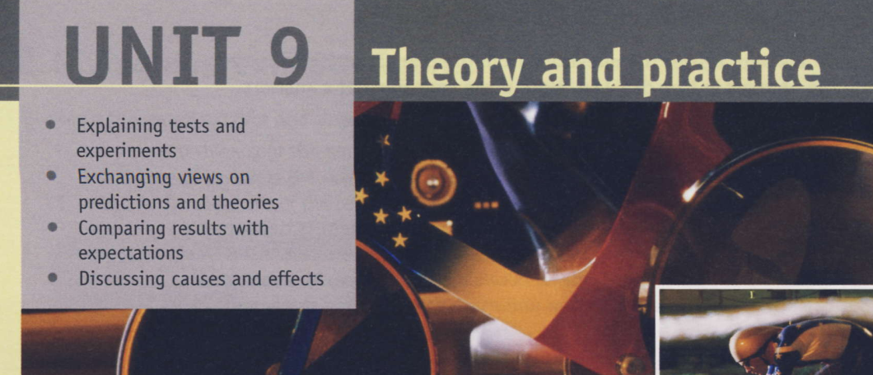

Notes:
Language note You will find the following vocabulary useful in this section. back-to-back test, full-scale, reduced scale, in the field, computer model, scale model, mock-up, simulation, the acid test, trial run, tried-and-tested, validate, virtual (computer simulation) Before you begin … 1. Explain what is meant by a test and an experiment.
2. Give some examples of the types of test and experiment that engineers from different branches might carry out

Slide 2
This section focuses on technical experimentation and development of vehicles in the context of aerodynamic design (the study of how objects affect / are affected by a flow of air, either when moving through the air, or when subjected to a flow of air ).
The Wind tunnel is used for:
-computer modeling testing,
- reduced-scale testing,
-full-scale trials.

Slide 3
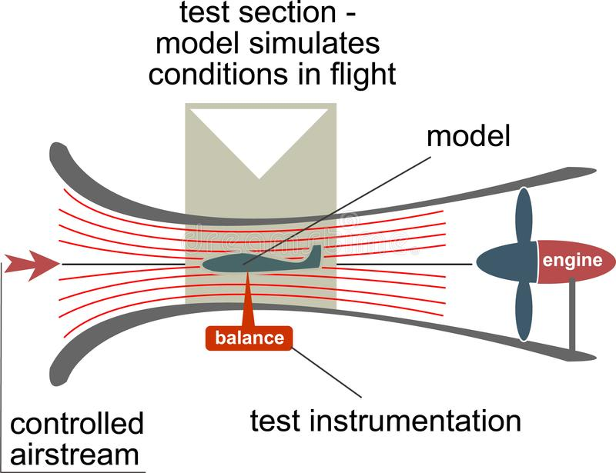
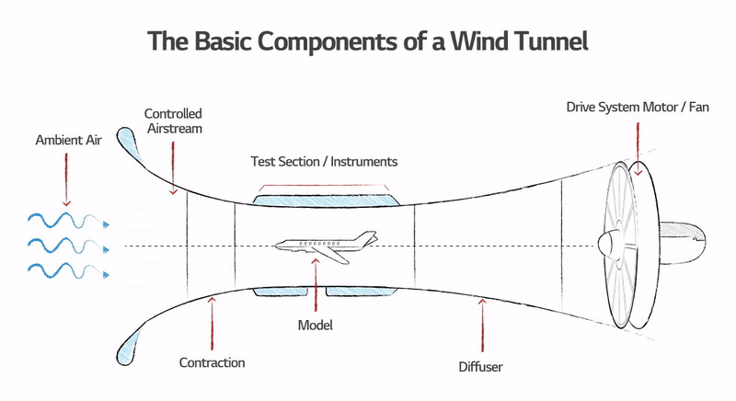
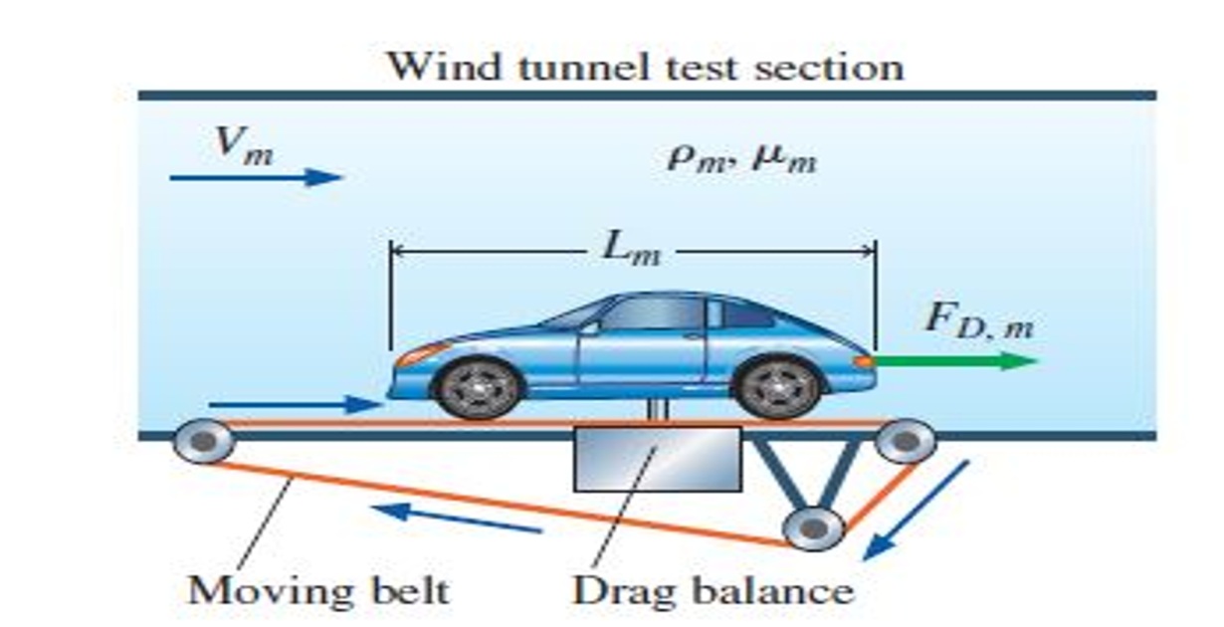
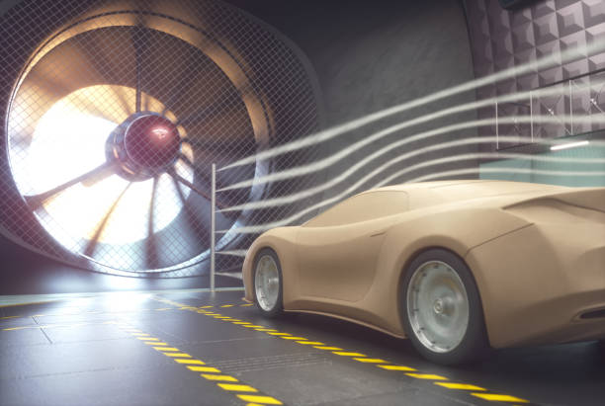

Slide 4
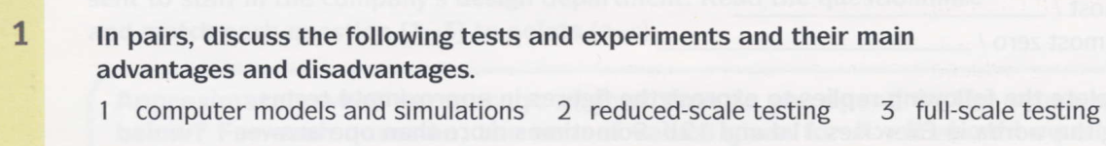
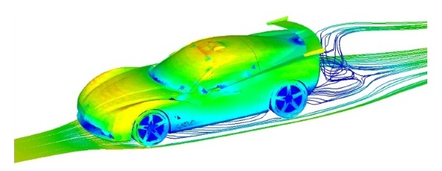
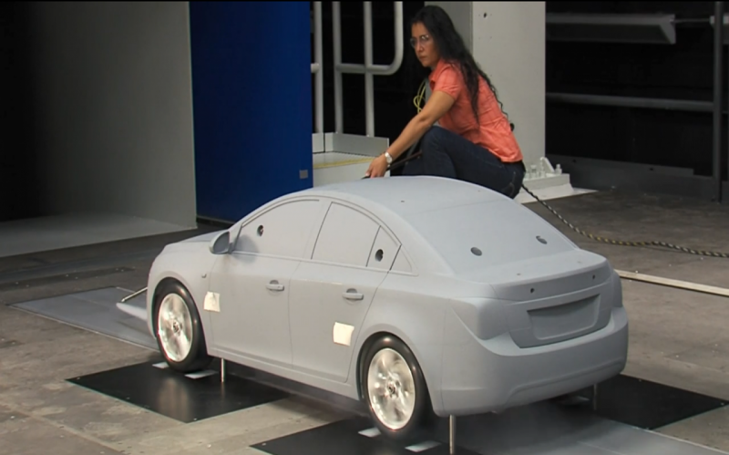
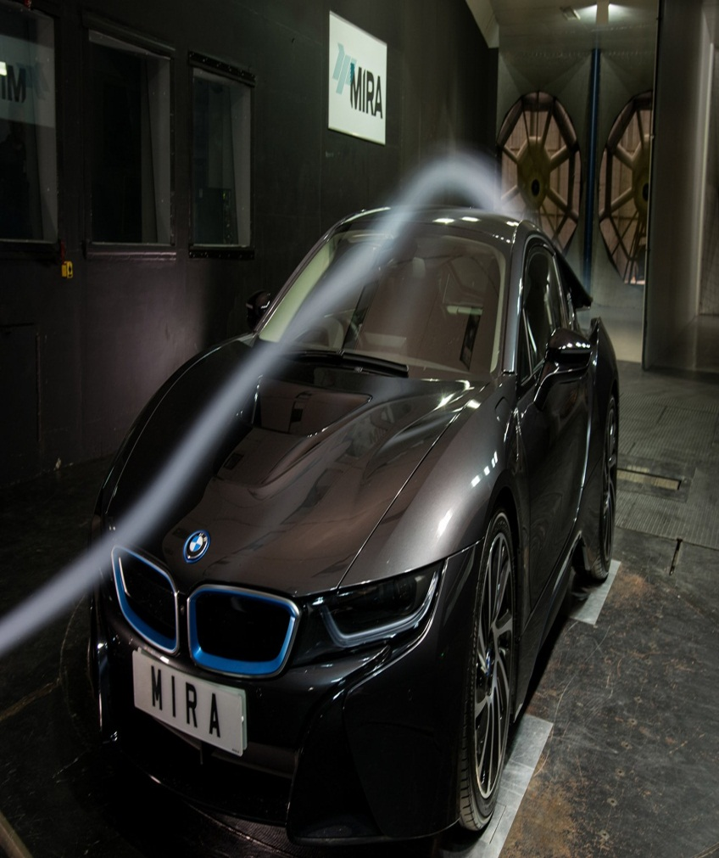
Notes:
1. Using software to simulate real-life situations. The main advantage ofthis technique is that testing is often faster and easier to undertake compared with real-life testing. Variables can also be changed easily. The main disadvantage is the lower degree of realism. 2. Testing small models of designs. The main advantage of this approach is that models are quicker and cheaper to build than full-sized prototypes. The main disadvantage is that their behaviour during tests cannot perfectly simulate that of a full-size prototype. 3. The main advantage of this approach is that tests are totally realistic. The main disadvantage is that full-scale prototypes can be expensive to build and test.

Slide 5
Using software to simulate real-life situations. The main advantage of this technique is that testing is often faster and easier to undertake compared with real-life testing. Variables can also be changed easily. The main disadvantage is the lower degree of realism.
Testing small models of designs. The main advantage of this approach is that models are quicker and cheaper to build than full-sized prototypes. The main disadvantage is that their behavior during tests cannot perfectly simulate that of a full-size prototype.
The main advantage of Large scale models is that tests are totally realistic. The main disadvantage is that full-scale prototypes can be expensive to build and test.

Slide 6
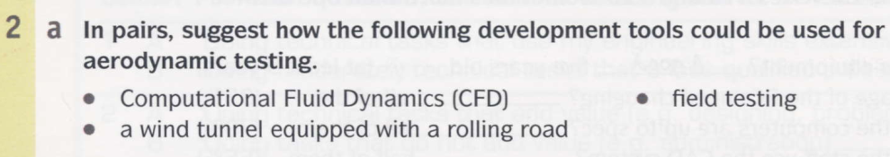

Slide 7
Computational Fluid Dynamics (CFD) is computer software used to assist in aerodynamic design. It models the flow of air over surfaces, such as car bodywork or the fuselage and wings of aircraft. Virtual testing with CFD software is typically done in the early stages of the design process.
Wind tunnels equipped with rolling roads allow reduced-scale models of vehicles or full-size vehicles to be tested. Air is blown through the tunnel by powerful fans to create airflows of different velocities which simulate the vehicle travelling at different speeds. The airflow over the surfaces of the vehicle is highlighted with streams of smoke, so that it can be analyzed. A rolling road is effectively a conveyor belt which moves beneath the stationary vehicle at the same speed as the airflow, making then wheels turn. This allows engineers to analyze the effects of the spinning wheels on the airflow.
Field testing refers to testing in real conditions. For aerodynamic testing of a vehicle, this might involve driving the vehicle at different speeds on a circuit or runway

Slide 8
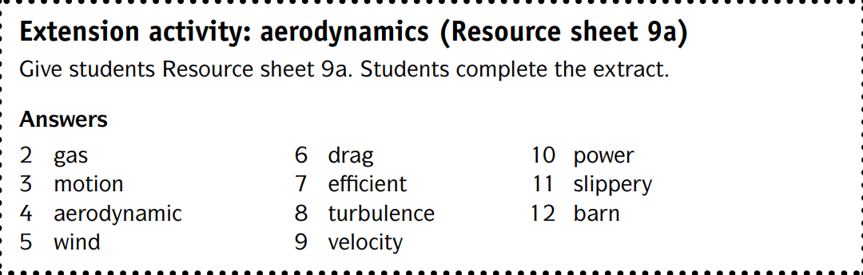

Slide 9

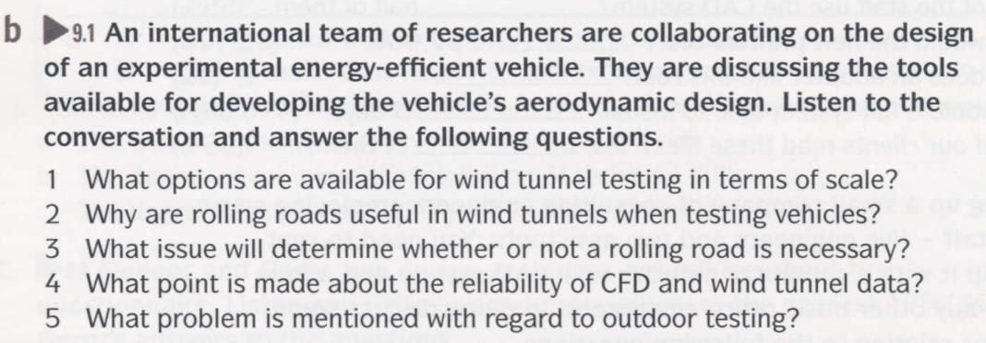
Notes:
Answers 1 Using a scale model or a full-size mock-up 2 To simulate the turbulence caused by wheels when they’re spinning 3 Whether or not the wheels are mostly enclosed by the bodywork 4 They are not a hundred percent reliable; the data needs to be validated by fullscale tests in real conditions. 5 Changeable weather makes it difficult to do back-to-back testing

Slide 10
Answers
Using a scale model or a full-size mock-up
To simulate the turbulence caused by wheels when they’re spinning
Whether or not the wheels are mostly enclosed by the bodywork
They are not a hundred percent reliable; the data needs to be validated by full scale tests in real conditions.
Changeable weather makes it difficult to do back-to-back testing

Slide 11
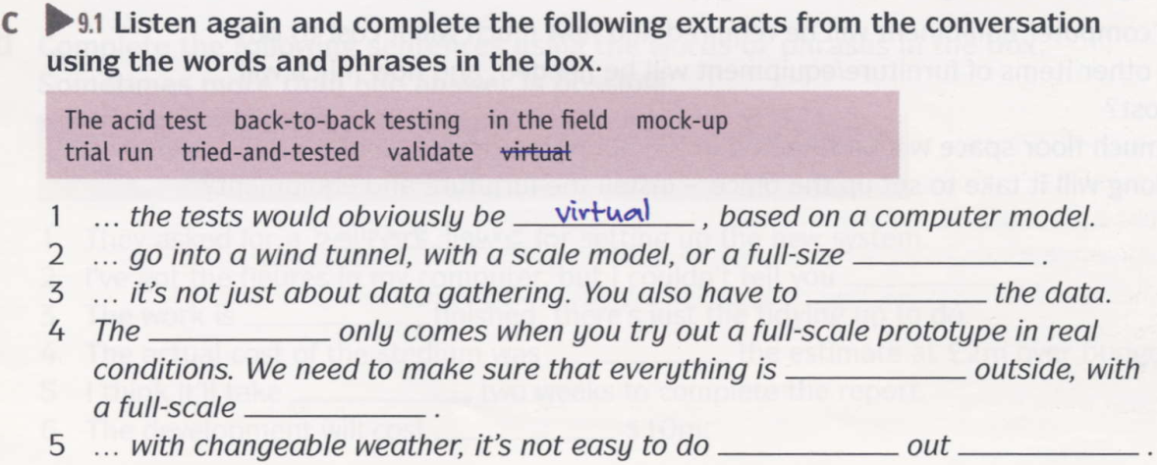
Notes:
2 mock-up
3 validate
4 acid test; tried-and-tested; trial run 5 back-to-back testing; in the field

Slide 12
mock-up
validate
acid test
tried-and-tested
trial run
back-to-back testing
in the field
Notes:
2 mock-up
3 validate
4 acid test; tried-and-tested; trial run 5 back-to-back testing; in the field

Slide 13
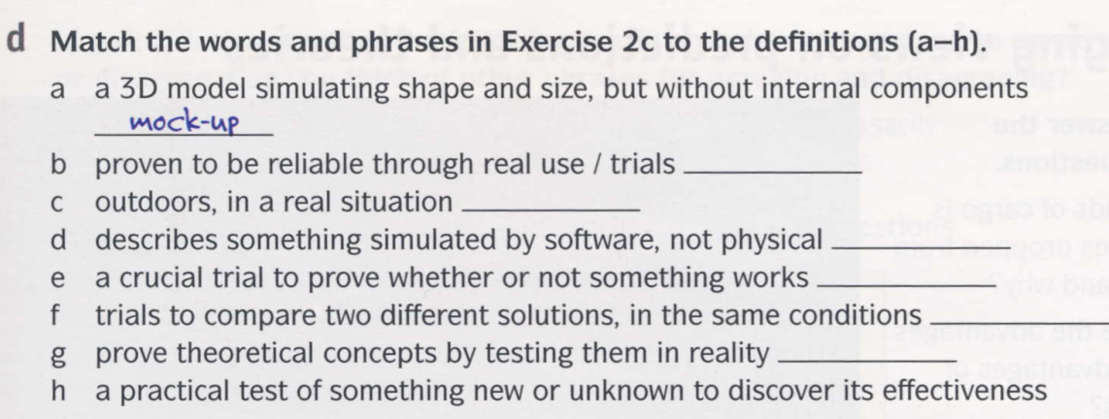
Notes:
Answers b tried-and-tested
c in the field
g validate
d virtual
h trial run
e the acid test
f back-to-back testing

Slide 14
tried-and-tested
in the field
virtual
the acid test
back-to-back testing
validate
trial run
Notes:
Answers b tried-and-tested
c in the field
g validate
d virtual
h trial run
e the acid test
f back-to-back testing

Slide 15
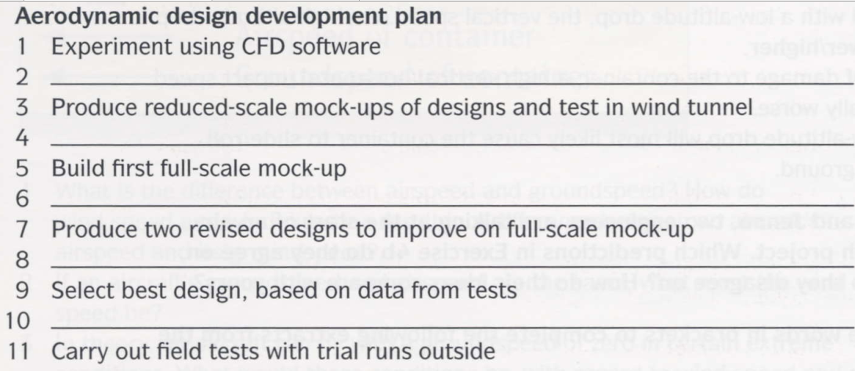
Notes:
2 e
4 d
6 a
8 b
10 c

Slide 16
Notes:
2 e
4 d
6 a
8 b
10 c

Slide 17
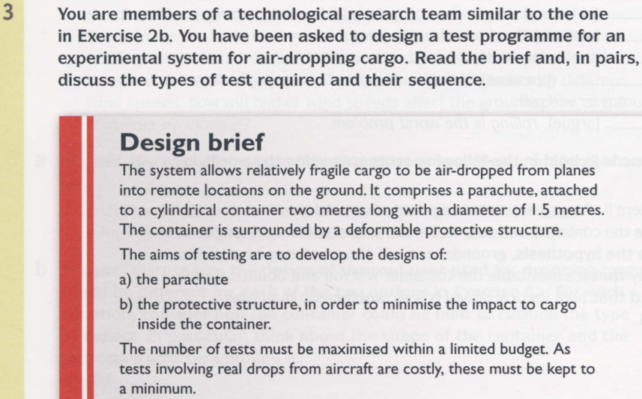

Slide 18
